Slide 1
White Rocks
Client Retention
SEMINAR GROUP 2 TEAM 8
DALINI VICKTORIA RAJANDHRAN (U1710158A)
NEO SAY YIN FLORENCE (U1910346G)
WANG WAYNE (U1920270G)
CHEE WEI KIAT COLIN (U1910457D)

Slide 2


Table of Contents
04
01
02
05
03
06
Overview
Proposed Solution -
Product Acceptance Model
Business Problem
Challenges & Consequences of inefficient client retention
Opportunities to improve client retention
Product Acceptance Model - Logistic
Product Acceptance Model - CART
Proposed Solution
Limitations of Solution
Preparation of Datasets
Predictive Techniques and their Basis of Comparison
Proposed Solution - Churn Model
Optimisation of Resource Allocation Process & Conclusion
Churn Model - Logistic
Churn Model - CART

Slide 3
Overview
Presenter: Dalini
Business Problem
Challenges surrounding client retention
Consequences of inefficient client retention
Opportunities to improve client retention

Slide 4



Business Problem
Presenter: Dalini
Changing customer sentiment due to the emergence of FinTech
Increased regulatory costs due to new requirements on transparency and openness reporting
Thinning Profit Margins

Slide 5

How are firms reacting
Presenter: Dalini
Focus on data driven insights to generate better returns
Mergers and Acquisition
?
Incorporate Automation to streamline processes
Re-designing fee structure
Increase Marketing Expenses to acquire more clients
Big emphasis on technological solutions

Slide 6
Important trends to Note
Presenter: Dalini
In the next 3 years…
39%
of Ultra-High-Net-Worth (UHNW) are expected to leave their current Asset Management Firm
90% of heirs are likely to use a different wealth management advisor from their parent
$58.1 Trillion
worth of assets are expected to be passed down from baby boomers to their next generation from 2007 - 2061,

Slide 7
Process to finding a solution
Opportunity Statement
Presenter: Dalini
Initial considerations
Area of focus
Improving profit margins
Increasing Revenue
Decreasing Costs
Availability of Data: preferably to tap on existing/ internal data
Areas which are often neglected
Customer Retention
Resource Allocation
Improve customer retention to ensure better allocation of resources
(i.e. marketing costs) to increase the revenue generated per dollar spent on a customer

Slide 8





Benefits of Client Retention
Presenter: Dalini
Less costly compared to Customer Acquisition
Open up opportunities for inter-generational selling
40%-65% more likely to try a new product and make purchases at premium prices

Slide 9

Implications of Poor Client Retention
Presenter: Dalini
Disgruntled Customers
Reputational Damage
Difficult to acquire them in the future

Slide 10
Difficulties in client retention
Presenter: Dalini
WIth 300 Years of History,
Operating in 32 markets globally
and a large web of intermediaries...
Large Consumer Base
Firms/ Startups with smaller consumer base
Sustained Engagement
Provide personalisation
White Rock
Costly to engage ALL clients on the same level

Slide 11
Opportunities
to improve
client retention
Presenter: Florence

Slide 12
Churn Rate
Presenter: Florence
Knowing how to retain existing clients is very important - predicting when or why clients churn
Increasing competition
Accurate and timely prediction
FACT: Banks can avoid up to 11% of churn just by being more proactive with client service at an early enough time period.

Slide 13
Churn Rate
Presenter: Florence
Most intuitive method :
Conduct comprehensive feedback through client surveys
costly to implement
some clients may provide non-truthful responses resulting in response bias.
The best approach :
Use advanced data science and machine learning techniques
Develop models which learn from data involving past client behaviours to find triggers which will contribute to churning and use this to predict future occurrences and odds of client churn

Slide 14
Client Retargeting
01
02
Presenter: Florence
Identification of current clients who we should target our marketing efforts at
Identify a possible pool of clients who are likely to churn,
Retarget high churn potential clients with new products to rejuvenate their client life cycle with the bank
“ Top 3 reasons why bank clients churn is due to ‘Poor Service’ , ‘Poor Communication’ and ‘Poor Product Match’ ”
~Qualtrics Banking Report
allows the bank to reconnect and communicate with their clients.
opportunity to provide a better product to the client to improve product match

Slide 15
Proposed Solution:
Client Retention Priority Model
Presenter: Florence

Slide 16
Churn Model
Presenter: Florence
Identify clients who are likely to churn based on certain variables
Filter out these clients - allow for better view on the clients the company should spend more resources retargeting
* From the developed model coupled with expert opinion, we found “Number of Products” to be a significant variable in influencing churn

Slide 17
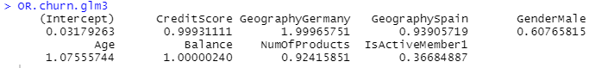
Churn Model
Presenter: Florence
- “Number of Products” a significant variable in influencing churn
CART model variable importance for age is the highest, followed by number of products
OR from logistic model suggests that the more number of products owned by the client, the less likely he will churn
Can spend resources promoting products to clients who are predicted to churn to induce them to act otherwise

Slide 18
Presenter: Florence
Product Acceptance Model
Predict the likelihood of one taking up a product with the company
Further streamline clients : Identify those who are of higher priority ( likely to churn but are predicted to accept additional products from us)
reduce the likelihood of them churning.

Slide 19
Client Retention Priority Model
Presenter: Florence
Integrate results from both models to give the company an accurate representation on specific individuals and their priority level
Churn | Acceptance | Priority Indicator
0 | 0 | 0 (No Priority)
0 | 1 | 0 (No Priority)
1 | 0 | 1 (Low Priority)
1 | 1 | 2 (High Priority)
Client Retention Priority = Churn + (Churn x Acceptance)

Slide 20
Proposed Solution:
Preparation of Dataset
Presenter: Florence

Slide 21
Preparation of Dataset
Datasets used found on Kaggle: (1) Bank Churn & (2) Personal Loan Classification.
Did the necessary adjustments to the variable columns by identifying the appropriate continuous and categorical variables.

Slide 22
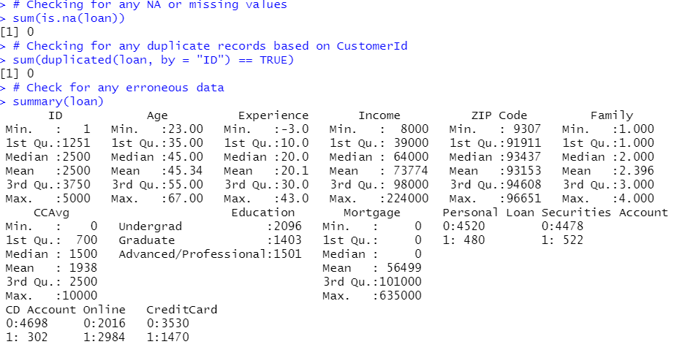
Cleaning of Dataset
Presenter: Florence
Checking for duplicate and missing values
Bank Churn dataset was rather clean
Personal Loan Classification dataset found that some clients had negative values for years of professional experience.
Presenter: Florence

Slide 23
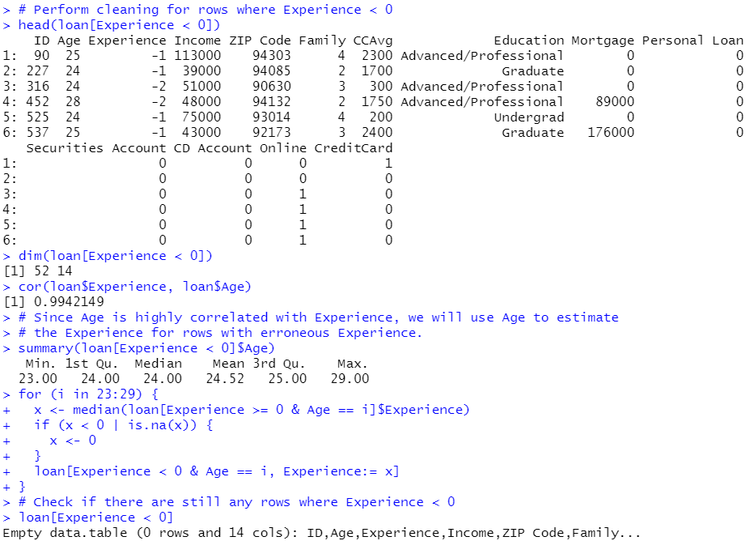
Cleaning of Dataset
Presenter: Florence
No proper description given to address the interpretation of negative experience - assumed that those were erroneous rows
-> Use the median years of experience for each age to estimate years of experience.

Slide 24
Proposed Solution:
Predictive Techniques and their Basis of Comparison
Presenter: Florence

Slide 25
Predictive techniques and their basis of comparison
Presenter: Florence
We chose to compare logistic regression and CART models.
Outcome variable is categorical
simple, easy to understand and implement
After obtaining the optimal models for each predictive technique, we:
Compare between Logistic and CART accuracies
Consider the practicality of implementation of each model

Slide 26
Predictive techniques and their basis of comparison
Presenter: Florence
Compare between Logistic and CART accuracies
misclassification error
the frequency and type of misclassification error that has occurred - lower false positives or false negatives reflects a model with higher accuracy.
Consider the practicality of implementation of each model
Conclude on which model to use by weighing both the accuracy and practicality of each model.

Slide 27
Proposed Solution:
Churn Model
Churn Model - Logistic Regression
Churn Model - CART

Slide 28
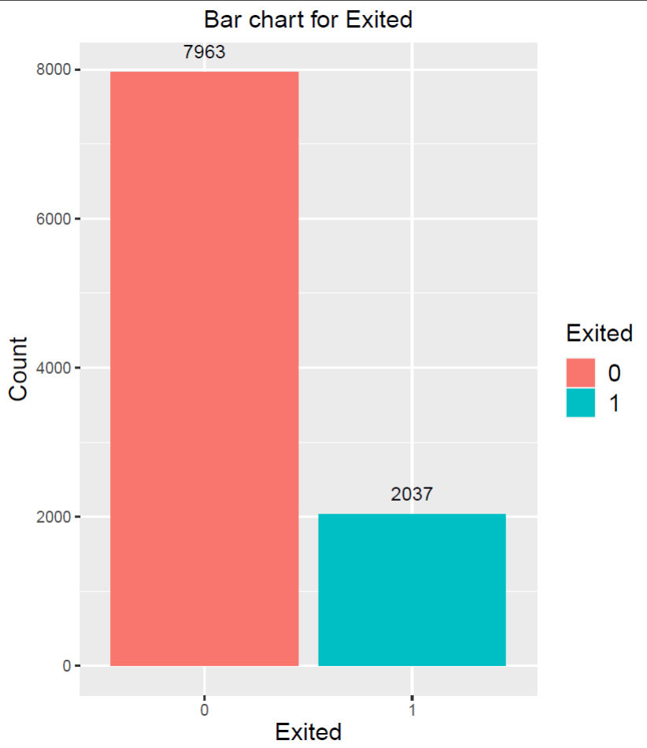
Churn Model - Visualization
Presenter: Wayne

Slide 29
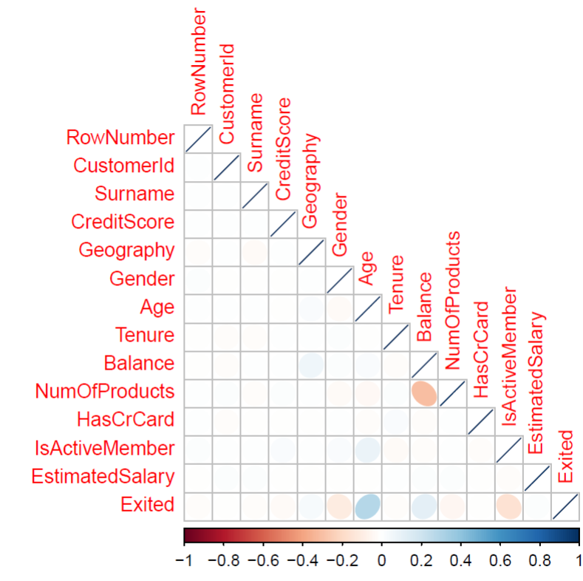
Churn Model - Visualization
Presenter: Wayne

Slide 30
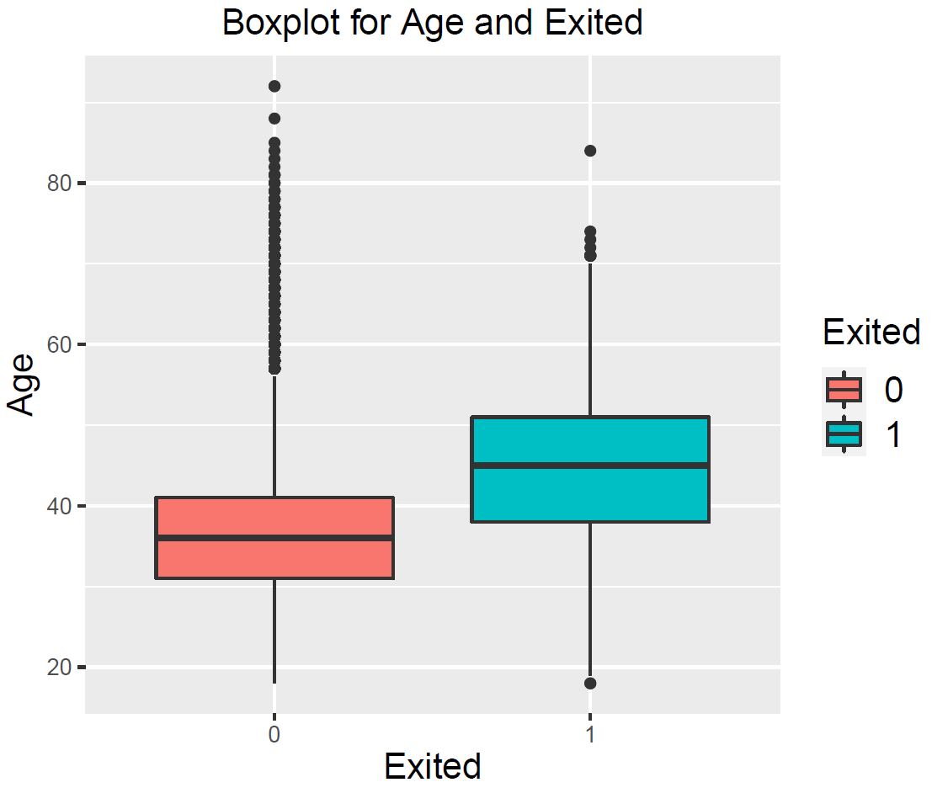
Churn Model - Visualization

Slide 31
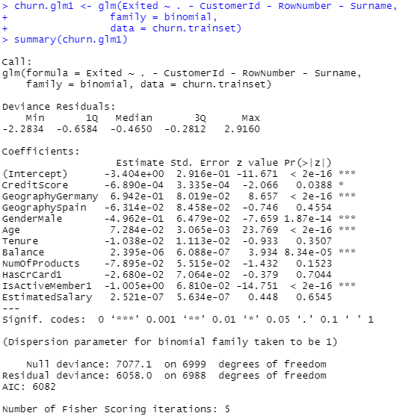
Churn Model - Logistic Regression
Presenter: Wayne

Slide 32
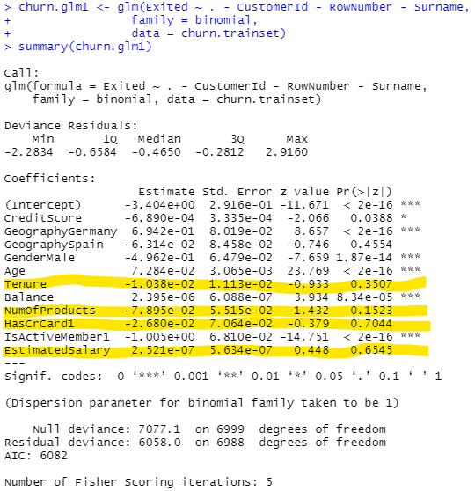
Churn Model - Logistic Regression
Presenter: Wayne

Slide 33
Churn Model - Logistic Regression
Is EstimatedSalary a weak predictor?
Presenter: Wayne
sd(churn$EstimatedSalary) = $57510
churn$EstimatedSalary57510 <- churn$EstimatedSalary / 57510

Slide 34
Churn Model - Logistic Regression
Is EstimatedSalary a weak predictor?
Presenter: Wayne
Since a $57510 increase in Estimated Salary only increases the Odds of ‘Exited’ by a mere factor of 1.028, Estimated Salary is indeed a weak predictor.

Slide 35
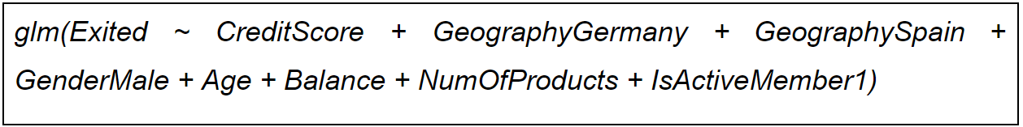
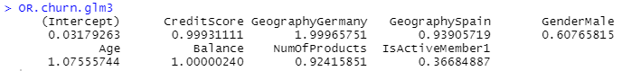
Churn Model - Logistic Regression
Presenter: Wayne

Slide 36
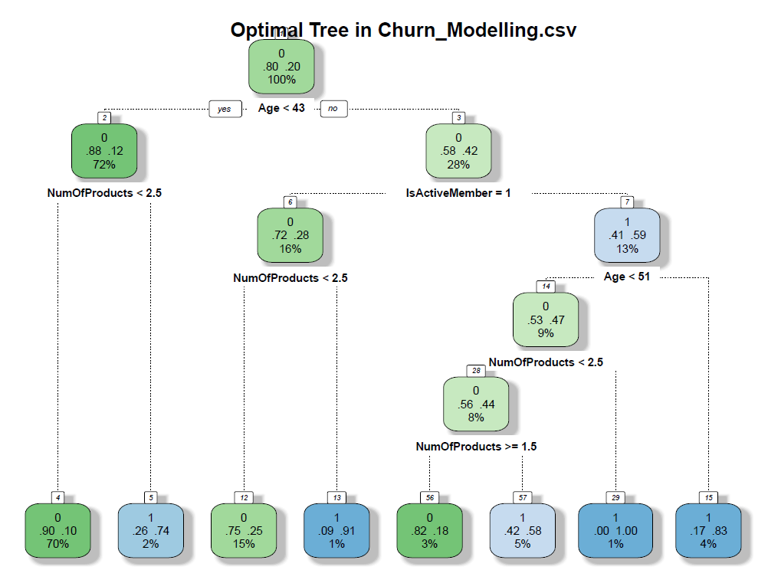
Churn Model - CART
Presenter: Wayne

Slide 37
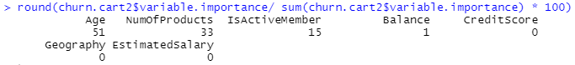
Churn Model - CART
Presenter: Wayne

Slide 38
Churn Model
Model Comparison
Presenter: Wayne
Basis of Comparison 1: Higher Test Set Accuracy for CART Model
Logistic Model
CART Model
0
1
0
1
0
2306 | 83
469 | 142
0
2299 | 90
330 | 281
Vs
1
1
Accuracy: 80.84%
Accuracy: 85.23%
Conclusion:
Inclined to choose CART model
Higher Model Accuracy

Slide 39
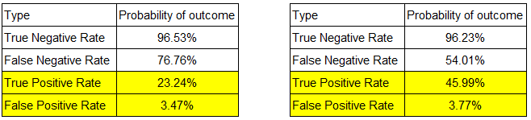
Churn Model
Model Comparison
Presenter: Wayne
Basis of Comparison 2: Higher True Positive Rate and
Lower False Positive Rate for CART Model
Logistic Model
CART Model
Conclusion:
Inclined to choose CART model
Much Higher TPR

Slide 40
Proposed Solution:
Product Acceptance
Model
Presenter: Wayne
Product Acceptance Model - Logistic
Product Acceptance Model - CART

Slide 41
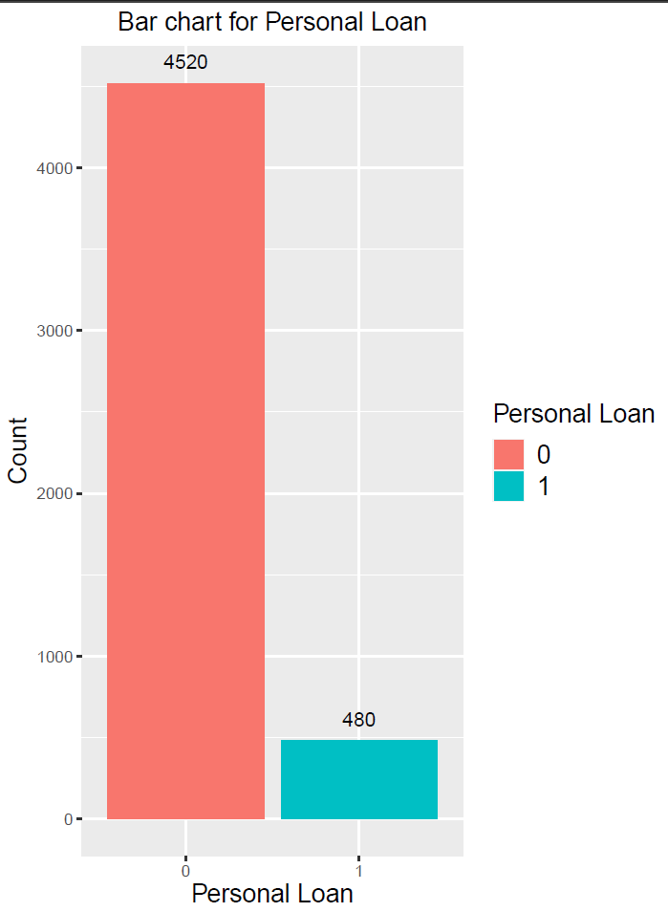
Product Acceptance Model Logistic Regression
Presenter: Wayne

Slide 42
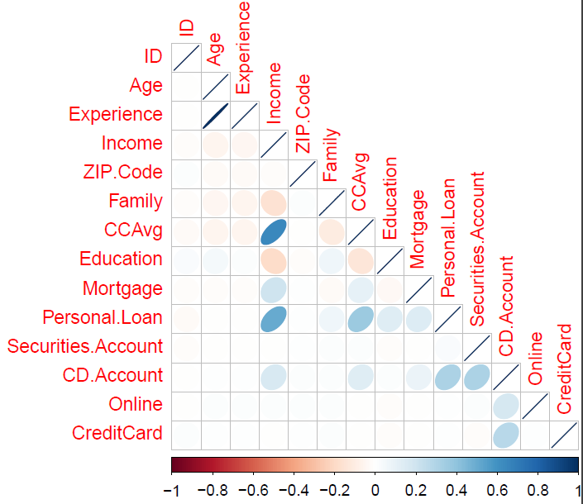
Product Acceptance Model Logistic Regression
Presenter: Wayne

Slide 43
Product Acceptance Model Logistic Regression
Presenter: Wayne

Slide 44
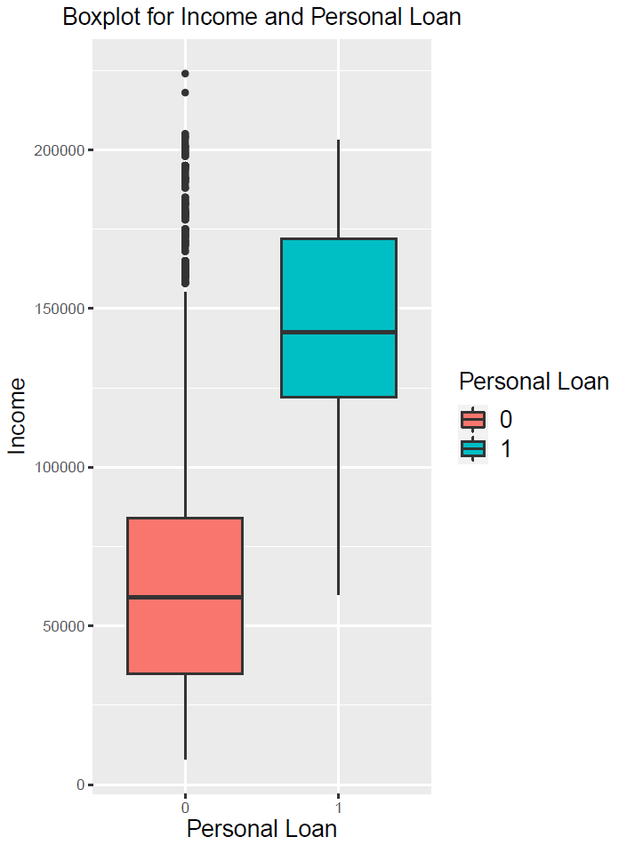
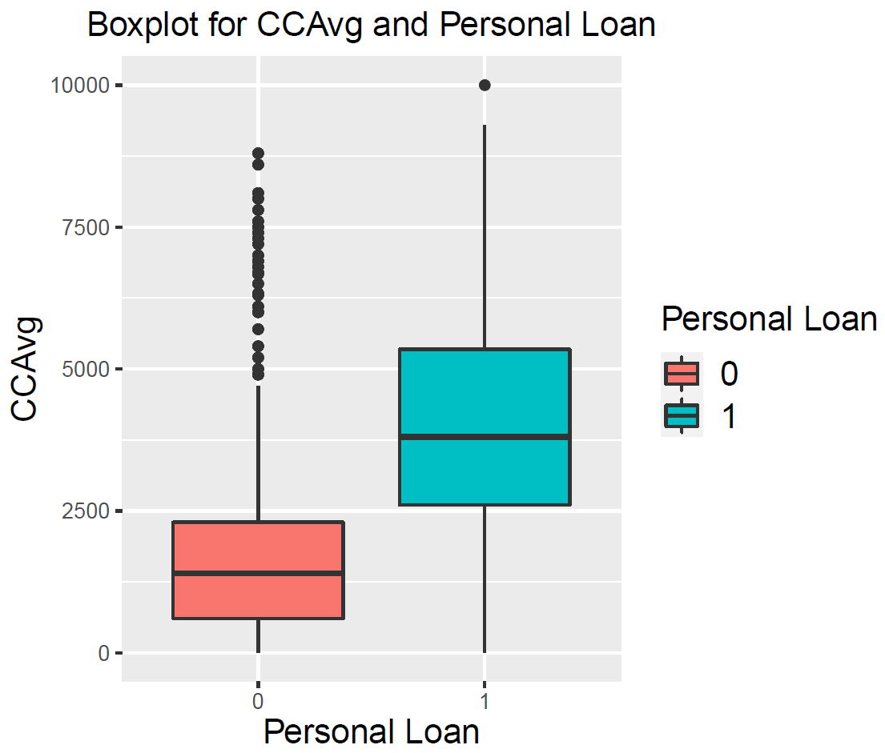
Product Acceptance Model Logistic Regression
Presenter: Wayne

Slide 45
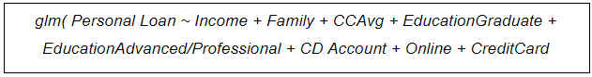
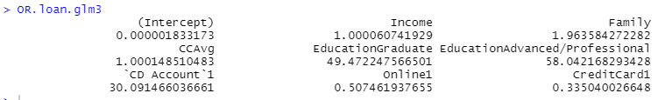
Product Acceptance Model
Logistic Regression
Presenter: Wayne

Slide 46
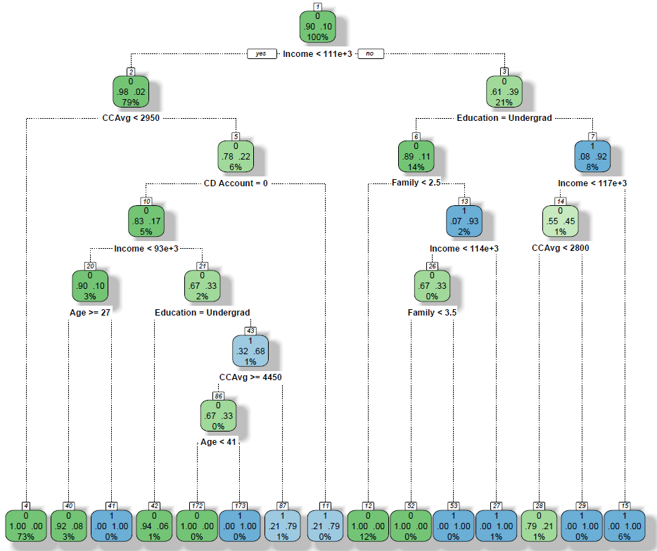
Product Acceptance
Optimal CART Model
Presenter: Colin

Slide 47
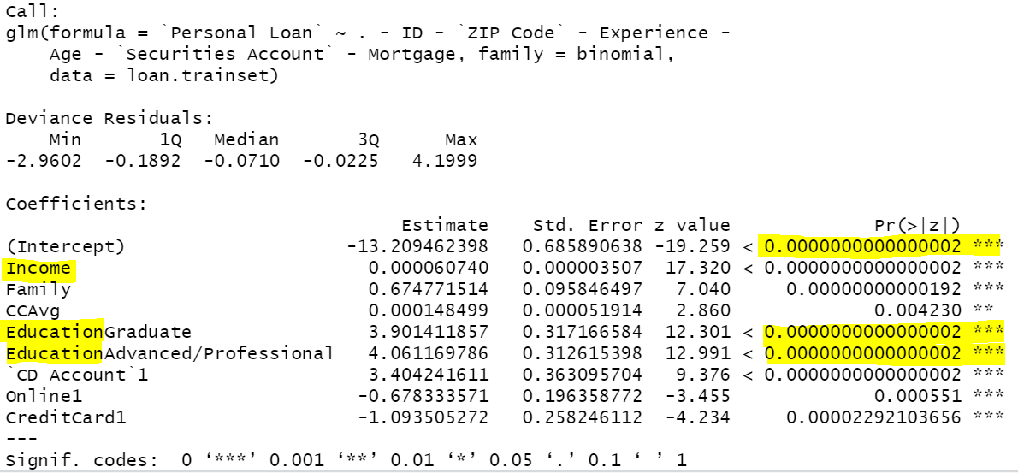
Product Acceptance
CART Model
Presenter: Colin
Variable Importance
Product Acceptance Logistic Model Summary

Slide 48
Product Acceptance
Model Comparison
Presenter: Colin
Basis of Comparison 1: Higher Test Set Accuracy for CART Model
Predicted Logistic Model
Predicted CART Model
0
1
0
1
0
1340 | 16
51 | 93
0
1347 | 9
16 | 128
Vs
1
1
Accuracy: 95.53%
Accuracy: 98.33%
Conclusion:
Inclined to choose CART model
Higher Model Accuracy

Slide 49
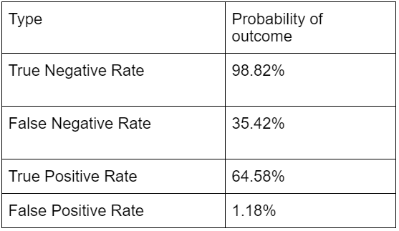
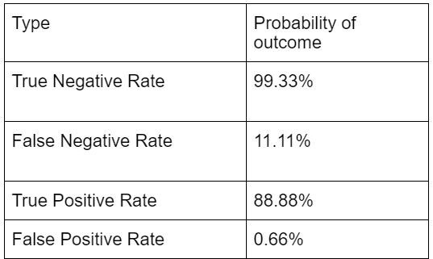
Product Acceptance
Model Comparison
Presenter: Colin
Basis of Comparison 2: Lower False Positive Rate for CART Model
Logistic Model
CART Model
Vs
Implications of Error:
Severe to have high False Positive. (Allocate resources to sell product to client but client actually does not accept )
Conclusion:
Inclined to choose CART model
Lower False Positive Rate
Higher True Positive Rate

Slide 50
Product Acceptance
Model Comparison
Presenter: Colin
Basis of Comparison 3: Practicality of Implementing Model
Logistic
CART
Ease of Use and Understanding
Requires higher level statistical understanding
Coefficients do not represent weight of factor, but rather odds ratio
Visual representation of tree, easy to understand
Impact of Size of Dataset for Development
​Requires train-test split, which may be problematic if dataset size is small
Uses 10-fold cross validation
Treatment of Missing Values
Missing values will result in deletion of entire row of data
Does not have surrogate capability of CART.
Uses surrogates to deal with missing values

Slide 51


Limitations of Solution
Presenter: Colin

Slide 52
Limitations of Solution
Imbalanced Dataset
Unable to Consider complex Qualitative Reasons
Churn Dataset (20:80)
Product Acceptance Dataset (10:90)
Model may be bias to majority case and create high level of model accuracy
Limits effectiveness and accuracy of the model, leading to poor decision making
However, industry average churn rate is 25%
EY concluded that AM clients tend to switch during critical life changes
Change in job (61%). Having a child or getting married (50%). Divorcing and retiring (40% and 43%)
Intergenerational wealth transfer (50%)
However, model can develop an AI to use client social media data to pre-empt churn based on life events

Slide 53
Optimisation of Client Retention Priority Model
Presenter: Colin
Geographical Data
for Optimisation
Optimised Data Implementation
Ability to provide priority score for clients across WR’s 32 markets
Understand odds ratio of a client churning in market A compared to market B
Efficiently allocate cost according to specific market requirements
Serves as a good justification for any budget adjustments
Main datasource for the model is basic client information
Such data can be found internally and is standardised
Reduces costs and resource needed to gather and clean data
A self- sustaining model without reliance from public data

Slide 54
Optimisation of Client Retention Priority Model
Presenter: Colin
Optimised Insight Communication
Can potentially communicate insights more efficiently by automating the output
Automated Output: Client ID, priority score,amount of resources to be allocated to a client
Reduces the need for manual interpretation of results
Generate yearly reports to track changes in priority score
Attribute changes to an increase in model accuracy or successful client retention strategy

Slide 55
Conclusion
Presenter: Colin

Slide 56


THANK YOU

